Slide 1
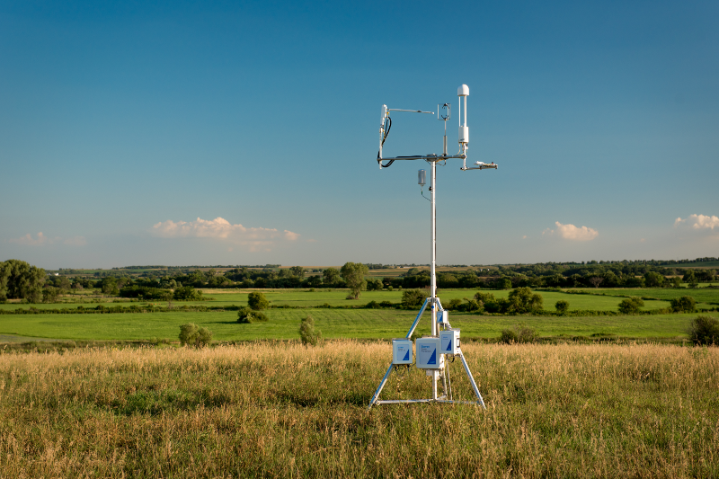
Eddy Covariance Data Lab
BIOL 16: Fall 2020
(much of these slides are from LI-COR’s George Burba)

Slide 2
What do we mean by carbon balance?
What are the components of carbon balance?
Notes:
Carbon balance ultimately is called NEE= Net Ecosystem Exchange
Components:
Photosynthesis, respiration from autotrophs/plants and heterotrophs (microbes/animals), aquatic losses (usually ignored), erosional losses (usually ignored)
Often NEE (net ecosystem exchange)=GPP (gross primary production)-Respiration (of autotrophs and heterotrophs)

Slide 3
How can the carbon balance of ecosystems be measured?
Notes:
They have done some of this in lab already. Measuring soil respiration is a component. Scientists often measure soil respiration (microbial respiration) and annual plant growth (which is equal to plant NPP).
In short-statured ecosystems, you can place a chamber over the whole ecosystem and measure the CO2 fluxes in and out. In these methods you need multiple samples to account for ecosystem heterogeneity and multiple timepoints to be able to estimate over the whole year.
Another way is with eddy covariance, which can use a single tower to measure a whole ecosystem. Advantages are that you get high temporal resolution, but only one spot. Eddy Covariance measures NEE directly.
There is also eddy covariance on aircraft, which can give you high spatial resolution (but no temporal resolution)

Slide 4
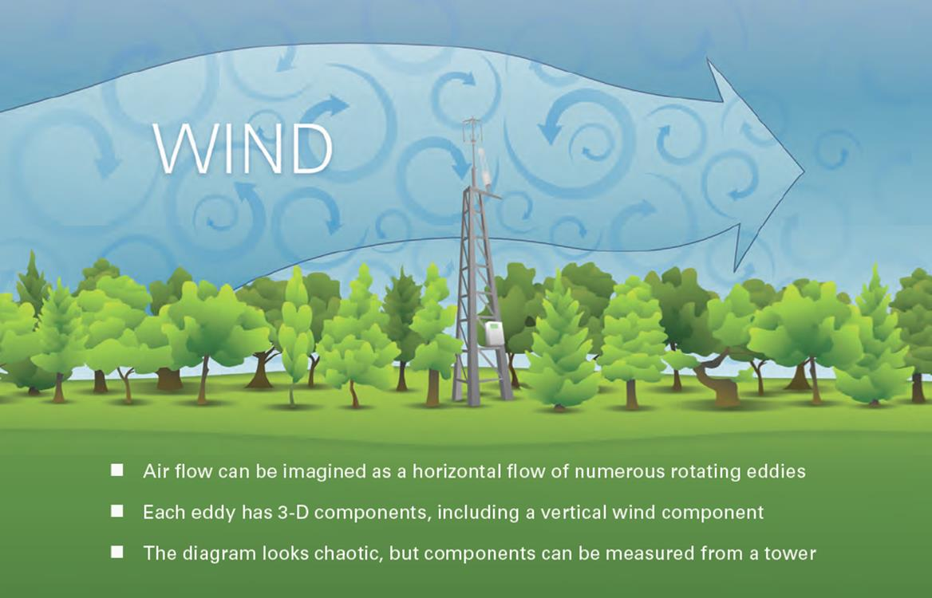
Air currents in ecosystems
Burba, Eddy Covariance Method, Part 1, © Li-Cor, 2013
Notes:
Burba, G., 2013. Eddy Covariance Method for Scientific, Industrial, Agricultural and Regulatory Applications: A Field Book on Measuring Ecosystem Gas Exchange and Areal Emission Rates. LI-COR Biosciences, Lincoln, USA, Hard- and Softbound, 331 pp. ISBN: 978-0-61576827-4

Slide 5
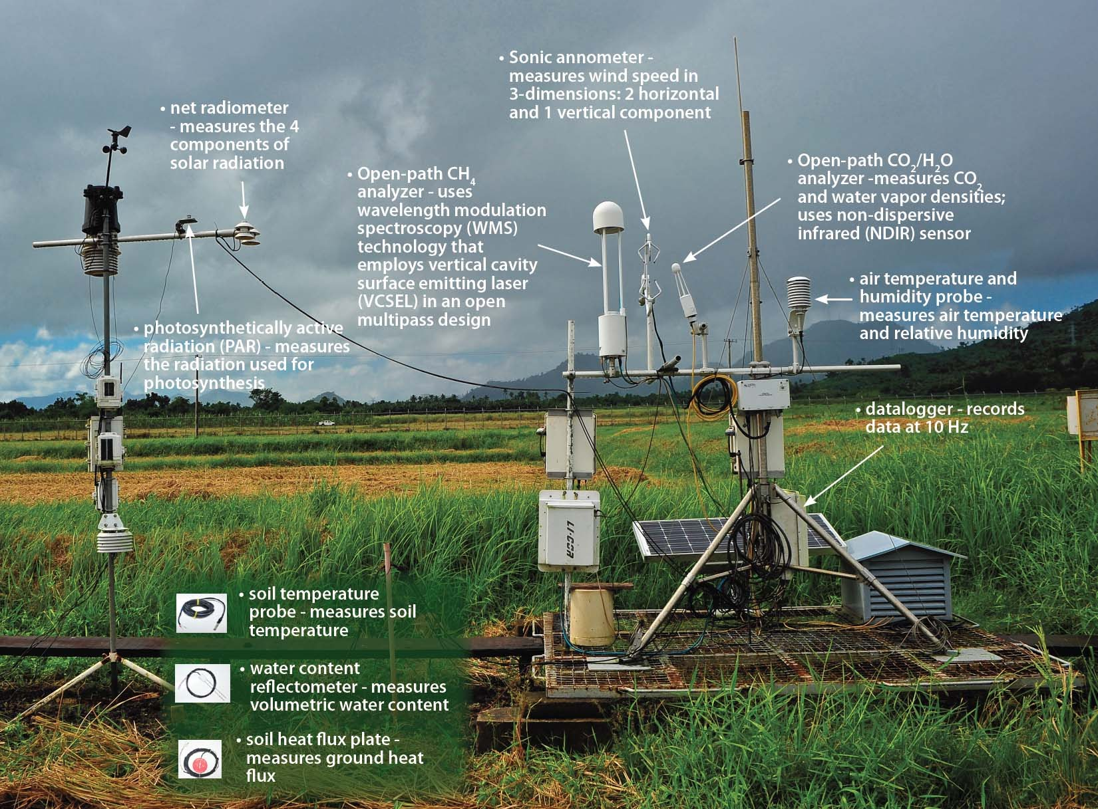
Components of a flux tower

Slide 6
Gas Analyzer and Sonic Anemometer
Omni-directional Sonic Anemometer
Open-path CO₂ / H₂O Gas Analyzer
Burba, Eddy Covariance Method, Part 2.2, © Li-Cor, 2013
Notes:
Burba, G., 2013. Eddy Covariance Method for Scientific, Industrial, Agricultural and Regulatory Applications: A Field Book on Measuring Ecosystem Gas Exchange and Areal Emission Rates. LI-COR Biosciences, Lincoln, USA, Hard- and Softbound, 331 pp. ISBN: 978-0-61576827-4

Slide 7
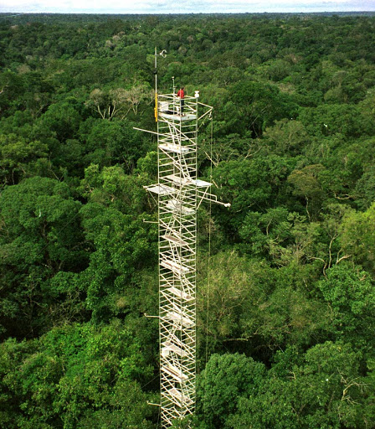
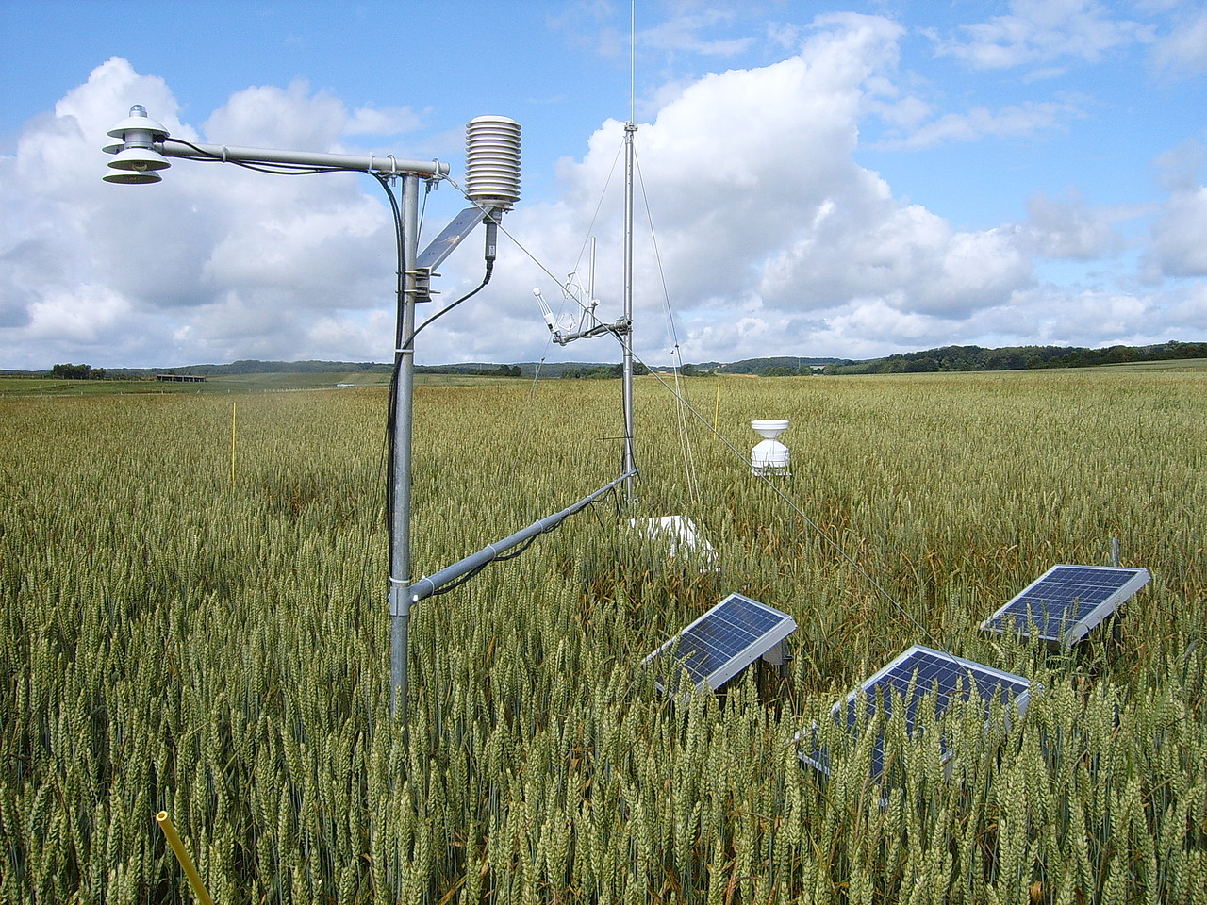
Notes:
Note the different heights of eddy covariance towers in crops versus rainforests. In order to make the measurement, the tower must be above the plant canopy. Also the taller the tower, the larger the footprint that it is measuring from.

Slide 8
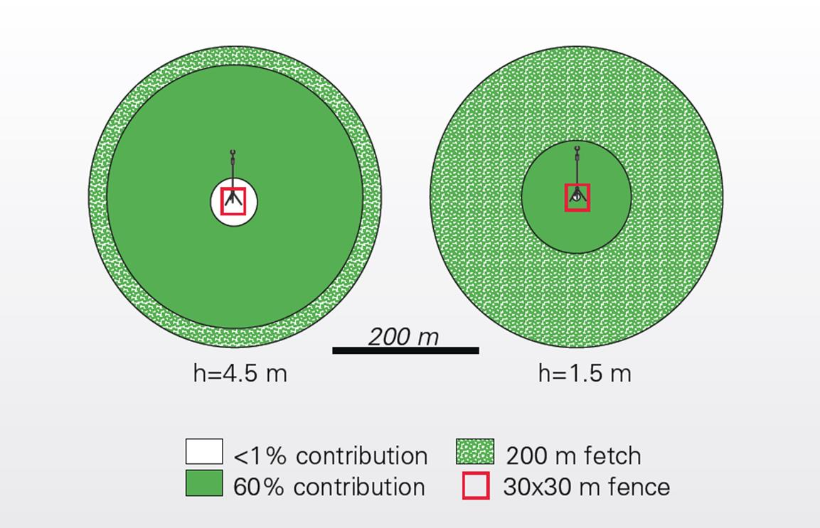
Effect of Station Height
Burba, Eddy Covariance Method, Part 2.7, © Li-Cor, 2013
Notes:
Burba, G., 2013. Eddy Covariance Method for Scientific, Industrial, Agricultural and Regulatory Applications: A Field Book on Measuring Ecosystem Gas Exchange and Areal Emission Rates. LI-COR Biosciences, Lincoln, USA, Hard- and Softbound, 331 pp. ISBN: 978-0-61576827-4

Slide 9
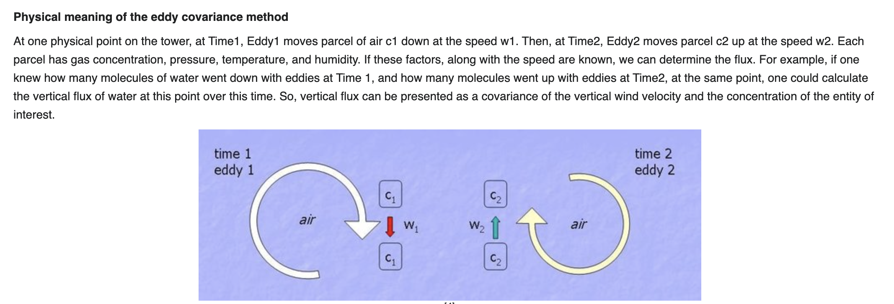
Covariance refers to how the wind velocity (positive to negative to represent up and down) and concentration of CO2 change together.
Notes:
From wikipedia

Slide 10
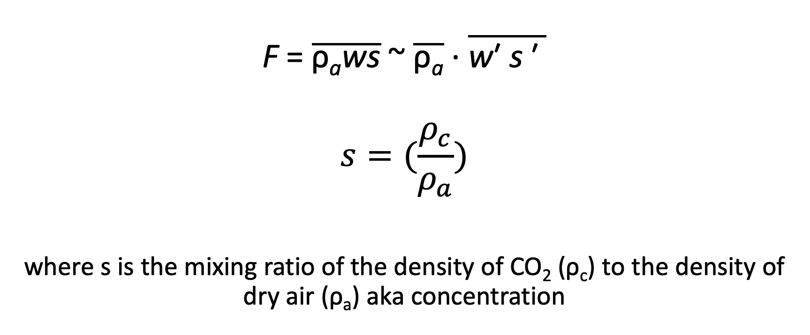
Eddy Covariance Flux density: mol/m²/s
$$\text{F} \text{= }\overline{\text{ρ}\text{a}\text{ws}} \text{\sim }\overline{\text{ρ}\text{a}} \text{∙ }\overline{\text{w}\text{′ }\text{s} \text{′ }}$$
$$s=(\frac{ρ_{c}}{ρ_{a}})$$
where s is the mixing ratio of the density of CO₂ (ρ_{c}) to the density of dry air (ρ_{a}) aka concentration
covariance
term
Notes:
after Baldocchi, UC Berkley, ESPM 228, Adv. Topics in Micromet & Biomet, Lecture 3,”Micromet Flux Meas.” Methods, slide #6
Overbar = means; prime=deviation or variance
F is the flux, pa is the air density, w is the vertical wind speed, s is gas mixing ratio (concentration). Covariance is the instantaneous deviation in vertical wind speed from the mean times the instantaneous deviation in the concentration from the mean times the average air density (which is assumed not to change),

Slide 11
Eddy Covariance Flux density: mol/m²/s
Measured by sonic anemometer
$$\text{F} \text{= }\overline{\text{ρ}\text{a}\text{ws}} \text{\sim }\overline{\text{ρ}\text{a}} \text{∙ }\overline{\text{w}\text{′ }\text{s} \text{′ }}$$
$$s=(\frac{ρ_{c}}{ρ_{a}})$$
where s is the mixing ratio of the density of CO₂ (ρ_{c}) to the density of dry air (ρ_{a}) aka concentration
Measured by gas analyzer
Calculated from air T and
barometric pressure
Notes:
after Baldocchi, UC Berkley, ESPM 228, Adv. Topics in Micromet & Biomet, Lecture 3,”Micromet Flux Meas.” Methods, slide #6
Overbar = means; prime=deviation or variance
F is the flux, pa is the air density, w is the vertical wind speed, s is gas mixing ratio (concentration). Covariance is the instantaneous deviation in vertical wind speed from the mean times the instantaneous deviation in the concentration from the mean times the average air density (which is assumed not to change),

Slide 12
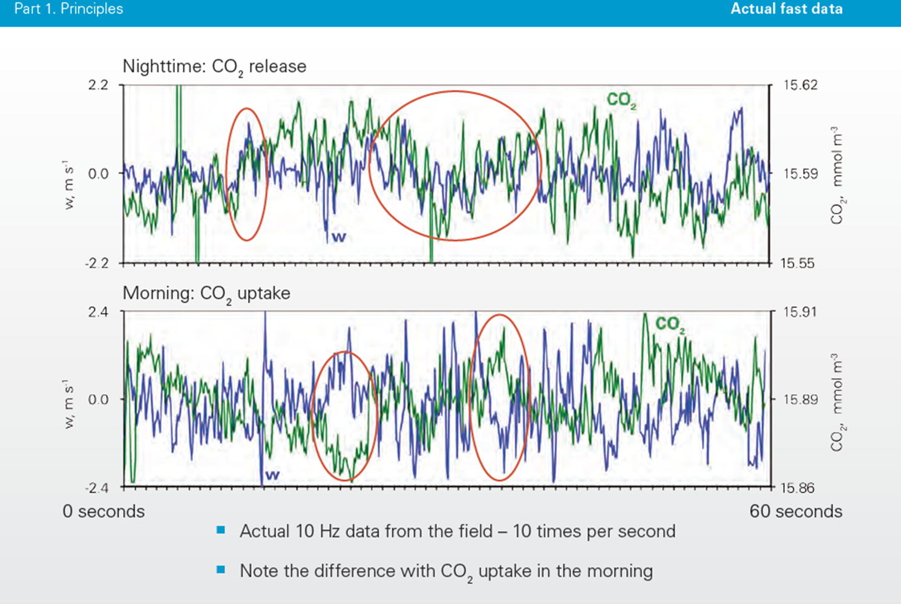
Example of “fast” Data
(red circles)
Burba, Eddy Covariance Method, Part 1, © Li-Corr, 2013
Notes:
Not sure whether we should show this as that is what they will be looking for.

Slide 13
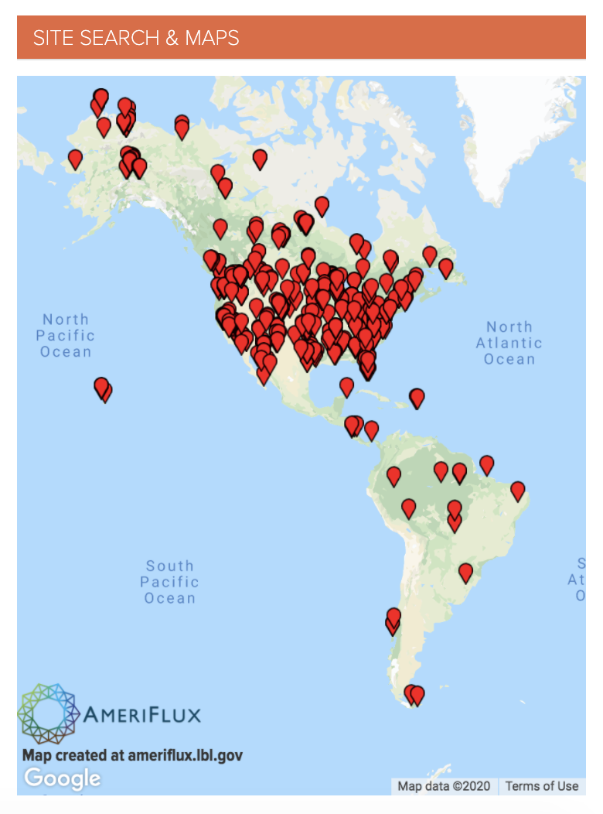
Ameriflux network of
eddy covariance towers
Important to know carbon balance across ecosystems and how they are responding to global change
Data is essential to validating and verifying Earth System Models that project future greenhouse gas levels

Slide 14
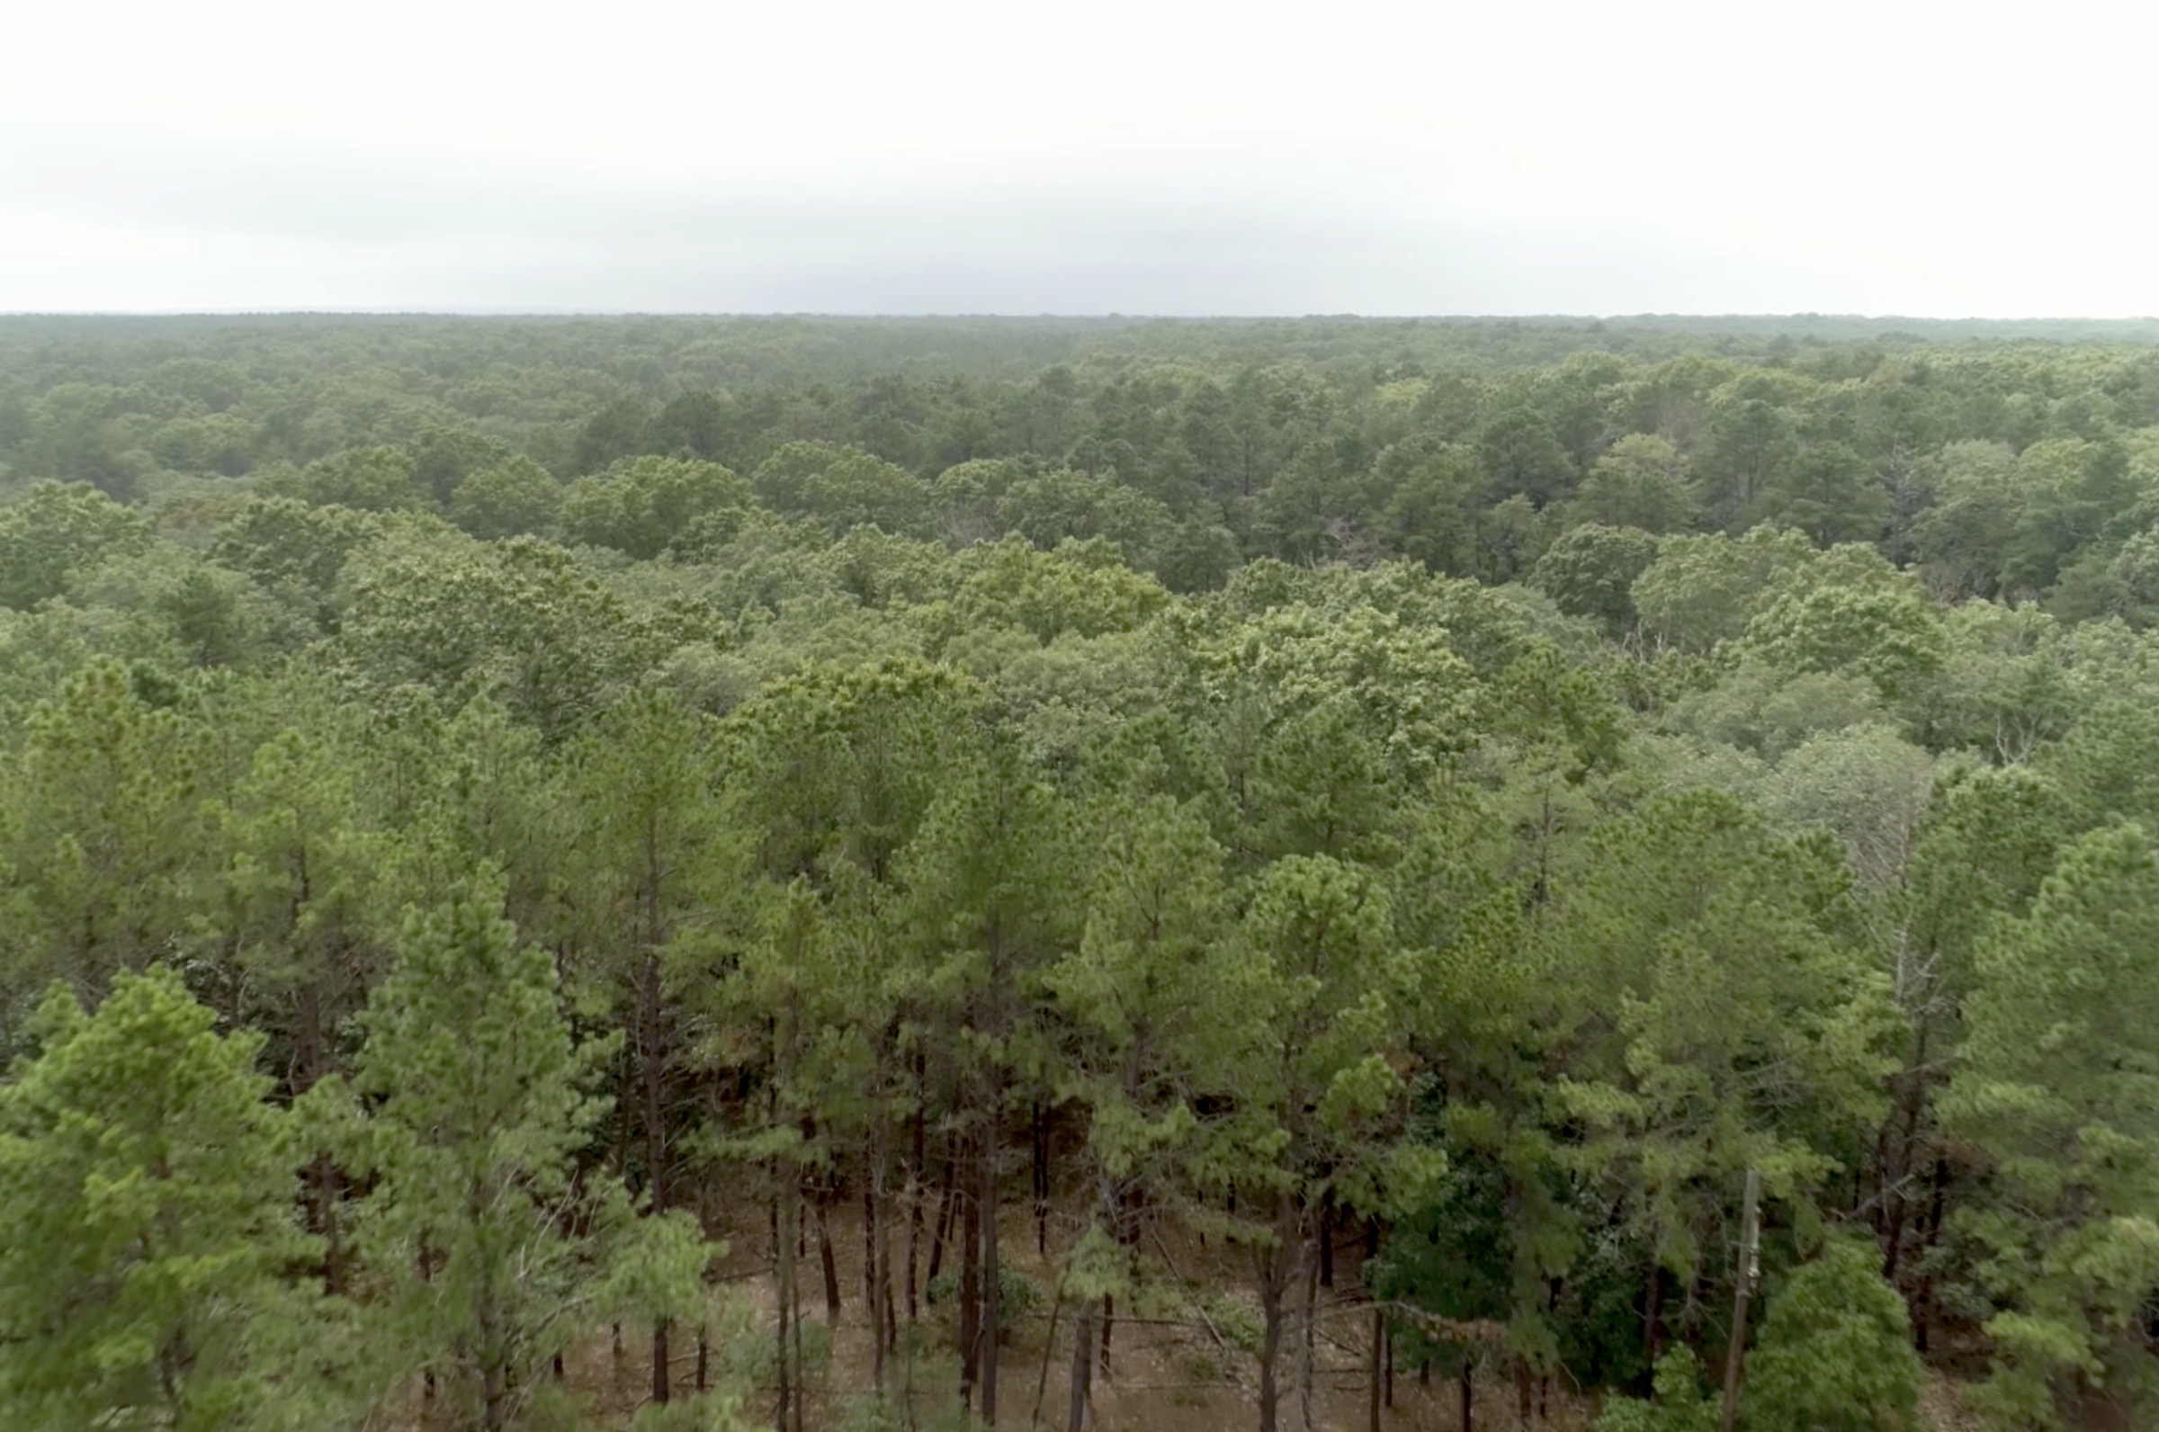
You will be working with data from an eddy covariance tower in the Silas Little Experimental forest in the New Jersey pine barrens.
Data were provided by Kenneth Clark of the US Forest Service.
Notes:
Not just pines, lots of oaks too!

Slide 15
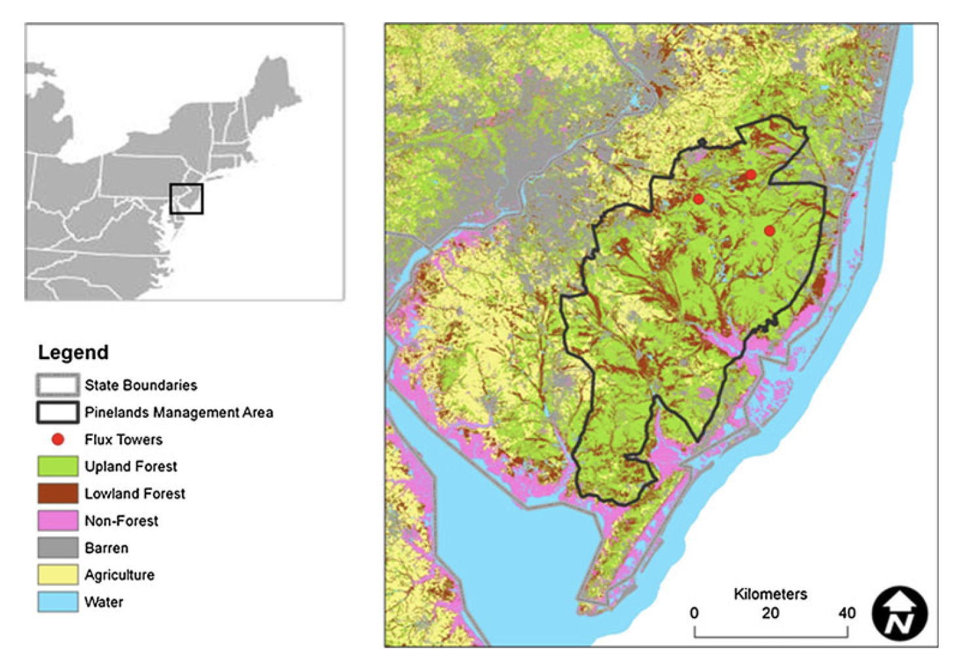

Slide 16
You will be working with data from an eddy covariance tower in the New Jersey pine barrens. First, you will explore the raw data to identify eddies and see how the CO2 and wind covaries. Second, you will work with calculated flux data to estimate the annual carbon balance of the ecosystem. - The flux data are reported half hourly - However, >30% of the data is missing and must be gap-filled.
Notes:
The catch is that there is a large percentage of the eddy covariance data (about 30-40%) that is not usable because the air was not turbulent enough, These have to be “gap-filled” using regressions of relationships btw the flux and weather variables before an annual flux can be calculated.

Slide 17
Gap-filling
When there is no turbulence or rain, the flux cannot be measured.
In order to get an annual estimate of carbon budget, we need to fill in these gaps in the flux data
To do so, we use a regression to relate weather and phenological variables to NEE. We can then use the resulting regression equation and the weather and phenological data collected by the tower to estimate NEE during the gaps.

Slide 18

The web module was designed by Quang Nguyen and Pierre Desvallons as part of Dartmouth’s DIFUSE program.
With input from Professor Hicks Pries and Professor Ayres

Slide 19
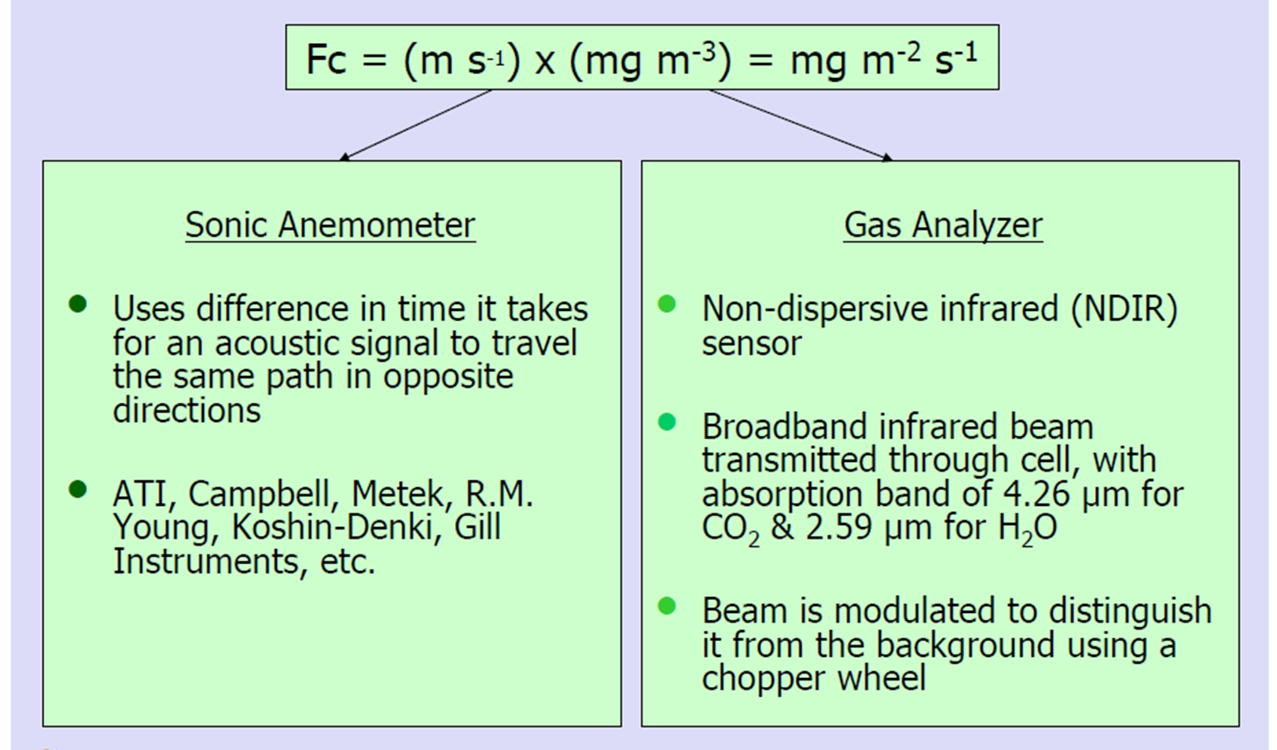
Measurement Principles
Burba & Anderson, Intro to the EC Method, Li-Cor, 2010
Notes:
Fc is the flux of carbon

Slide 20
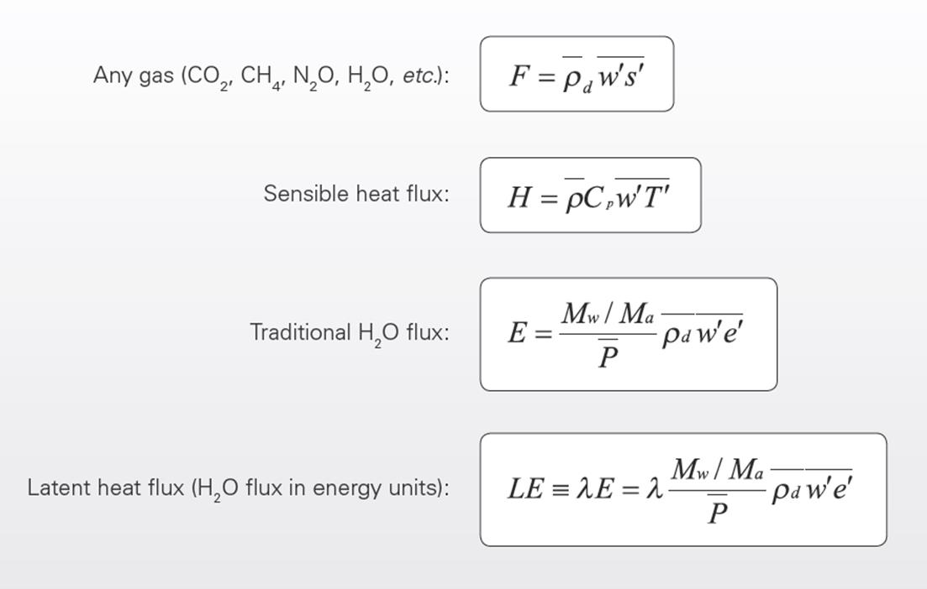
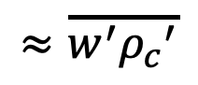
Practical Formulas
$$≈\overline{w^{′}{ρ_{c}}^{′}}$$
Burba, Eddy Covariance Method, Part 1, © Li-Cor, 2013
Notes:
Overbar = means; prime=deviation or variance
Burba, G., 2013. Eddy Covariance Method for Scientific, Industrial, Agricultural and Regulatory Applications: A Field Book on Measuring Ecosystem Gas Exchange and Areal Emission Rates. LI-COR Biosciences, Lincoln, USA, Hard- and Softbound, 331 pp. ISBN: 978-0-61576827-4

Slide 21
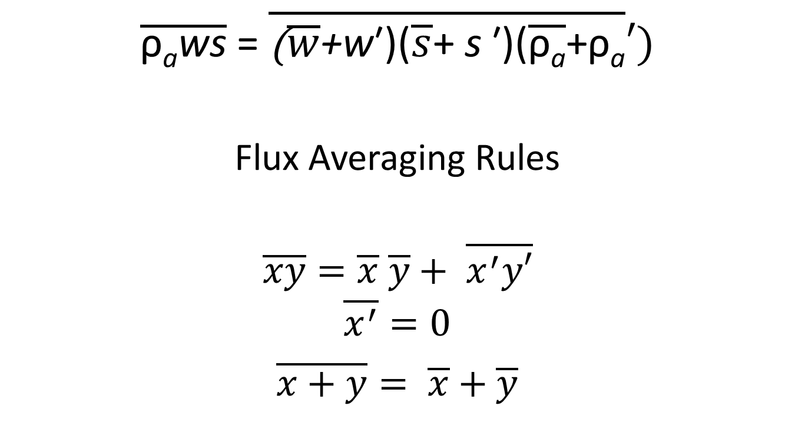
Reynolds Decomposition
$$\overline{\text{ρ}\text{a}\text{ws}} \text{= }\overline{\text{(}\overline{w}\text{+}\text{w}\text{′)(}\overline{s}\text{+ }\text{s} \text{′)(}\overline{\text{ρ}\text{a}}\text{+}\text{ρ}\text{a}}′)$$
Flux Averaging Rules
$$\overline{xy}=\overline{x} \overline{y}+ \overline{x^{′}y′}$$
$$\overline{x^{′}}=0$$
$\overline{x+y}= \overline{x}+\overline{y}$
Notes:
after Baldocchi, UC Berkley, ESPM 228, Adv. Topics in Micromet & Biomet, Lecture 3,”Micromet Flux Meas.” Methods, slide #11,12

